Slide 1
Constraint programming for Domain Independent temporal planning
July 26, 2018 Tao Hu
Supervisor: Christopher Beck, Chiara Piacentini

Slide 2
Outline
Motivation
Literature:
Contribution
Model Formulation
Problem Definition
Decision Variables
Constraints
Tests on benchmark instances
Conclusion

Slide 3
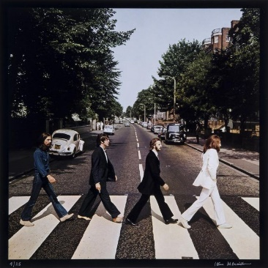
Motivation
Actions are durative
A lot of researches (e.g. Constraint Programming) has been done on Classic Planning problems with non-durative actions, i.e. we only check preconditions at the start of an action and actions make effects at the end of them.
Temporal Planning catches the fact that actions are durative and may conflicting with each other, but there is a lack of studies that build constraint programming model in a domain independent manner.
at start (turn on ? light)
overall (no hitting ?car)

Slide 4
Contribution
Related Works
A recent work on CP and Planning (Piacentini & Tran, 2017) gave a constraint programming model for domain independent classical planning problems.
‘PDDL 2.1: An Extension to PDDL for Expressing Temporal Planning Domains’ (Fox & Long, 2003) builds fundamentals for modelling temporal planning problems.
A specific example of using constraint programming to solve temporal planning problems (Booth & Nejat, 2016).
My work
The main purpose of my project is to extend the CP model to solve domain independent temporal planning problems.

Slide 5
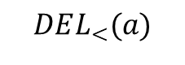
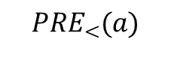
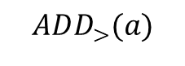
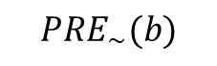
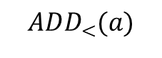
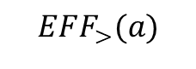
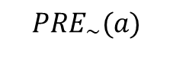
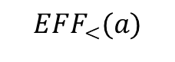
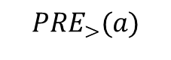
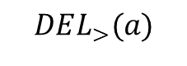
The CP Model: Problem Definition
A temporal planning task is a tuple
$$Π=\left\langle P, A, I, G\right\rangle$$
$$PRE_{<}(a)$$
$$PRE_{\sim }(a)$$
$$PRE_{>}(a)$$
Action a
$$ADD_{<}(a)$$
$$ADD_{>}(a)$$
$$EFF_{<}(a)$$
$$EFF_{>}(a)$$
$$DEL_{<}(a)$$
$$DEL_{>}(a)$$
$$PRE_{\sim }(b)$$
Action b

Slide 6
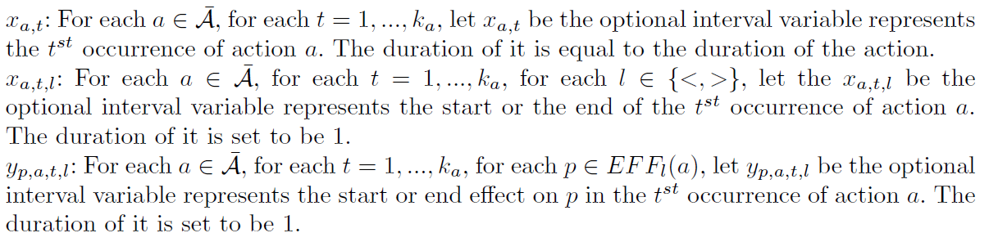
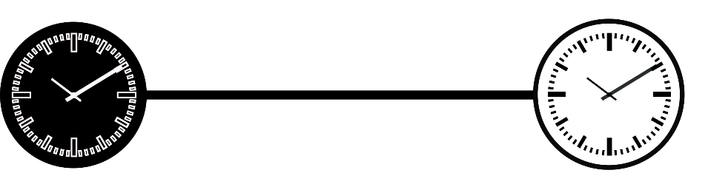
The CP Model: Decision Variables
Optional interval Variables

Slide 7
The CP Model: Decision Variables
Cumulative function

Slide 8
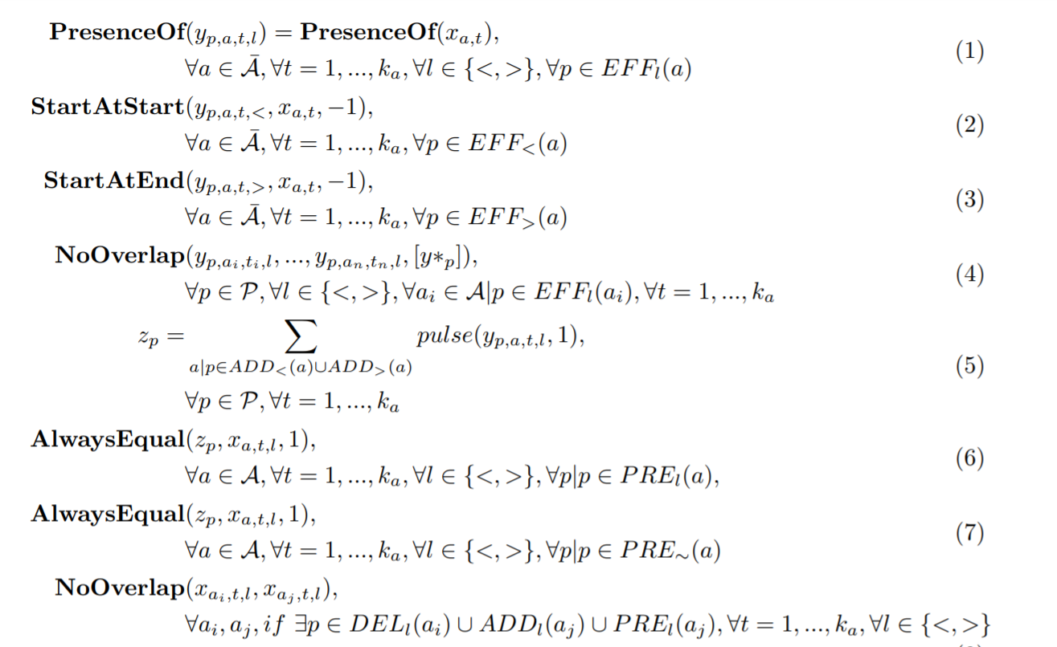
The CP Model: Constraints
OBJ: Min Makespan
Check Precondition
Separating Conflicting Actions

Slide 9
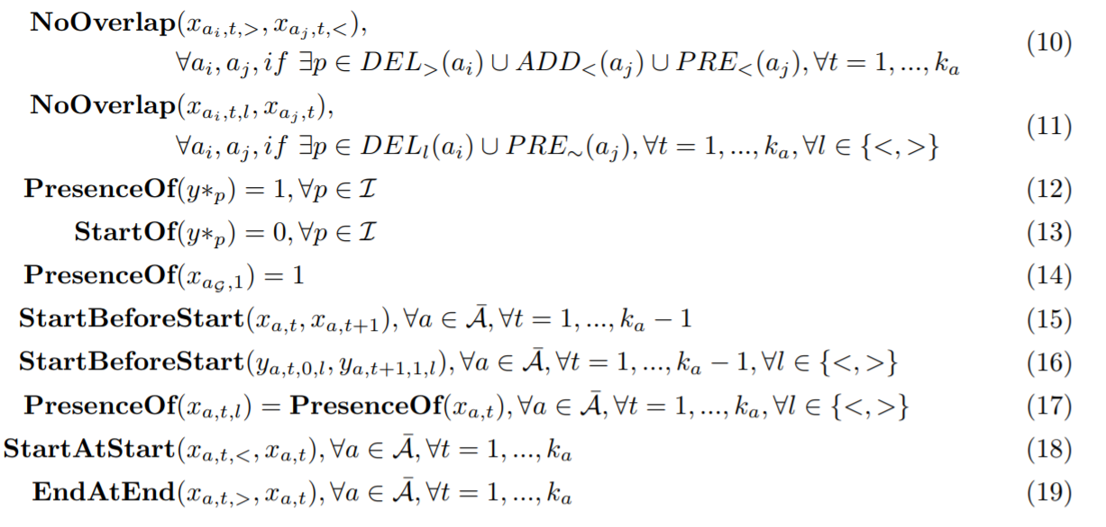
The CP Model: Constraints
Separating Conflicting Actions

Slide 10
Benchmark instances test
Summary of the number of instances solved (10 min)
Problem Domain | CP | Optic | Sapa
Crewplanning | 16 | 30 | 0
Printer | 5 | 14 | 6
OpenStacks | 13 | 30 | 30
Pegsol | 0 | 30 | 20
Sokoban | 0 | 11 | 0
Driver | 0 | 12 | 11
Note: The CP model will produce valid solutions for ‘driver’ and ‘printer’ instances, given sufficiently long time (30min +).
Tech Info: 2.5 GHz intel core i5, 4 gb 1600 mhz ddr3

Slide 11
Benchmark instances test
‘Openstack’ instances

Slide 12
Benchmark instances test
Results highlights
Generally, CP is not as fast as Optic, but CP usually produces solution with better objectives.
Crew Planning: CP produces results to more than half of the instances, while Sapa cannot produce any solution.
Parc Printer: There exists 2 instances solved by the CP model only.

Slide 13
Conclusion
CP works, but needs improvement in the speed…
Possible Improvements:
Avoid creating unnecessary variables
Smart Cut-offs

